Slide 1
Neuroinflammation as a Potential Biomarker and Therapeutic Target in CNS Disease and Injury
Gwenn Garden, M.D., Ph.D.
Department of Neurology
University of Washington

Slide 2
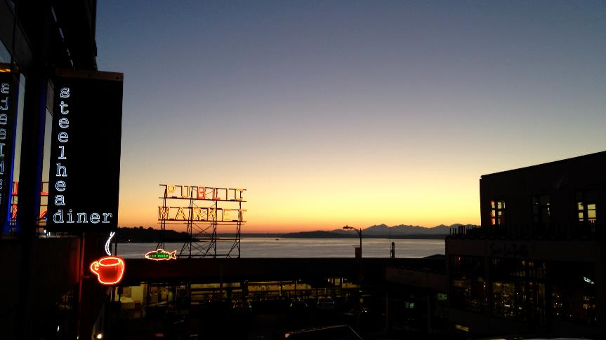
What about the environment?

Slide 3
Cells Mediating The CNS Response To Injury
The CNS includes several non-neuronal cell types.
  Neuroglia
    Myelin forming glia
    Ependymal Cells
    Astroglia
  Cells of the vascular system
  Cells involved in inflammation and immune response
    Macrophages
    Microglia

Slide 4
Microglia: Innate Immune Effector Cells Throughout The Lifespan
A. Postnatal CNS
B. Healthy adult CNS
C. Diseased adult CNS
Synaptic pruning
Phagocytosis
≈ 5 minute contact every hour
Synaptic stripping
Stroke, Trauma
Activity Dependent
Activity Dependent
Glaucoma, Alzherimer’s,
ALS
Inflammatory signals
Inflammatory signals
Inflammatory signals
Neurotrophic factors
Synaptic pruning
Resting
microglia
?
Cytokine Release
Activated microglia

Slide 5
The Variety of Microglia Behaviors
Homeostatic
TLR ligands
ROS
Proinflammatory
signals
Anti-inflammatory cytokines
Internalization of cellular debris
ATP
Chemokines
Neurotoxic
Repair
ROS
Proinflammatory signals
Excitatory Amino Acids
Responding
Neuroprotective Factors
Anti-inflammatory signals
Pro-angiogenic factor
Migration
ECM modification
Internalization
Garden and La Spada, 2012, Neuron

Slide 6
What Makes A Microglia, A Microglia?
Where do microglia come from?
  1980’s-1990’s – Microglia come from bone marrow.
    Microglia express common markers with cells of myeloid lineage.
    After bone marrow transplant, cells from graft enter the brain and look like microglia.
  2000’s – Microglia are unique to the CNS
    Experiments show little transit of myeloid cells into uninjured brain.
    Microglia gene expression patterns are distinct from those of other myeloid cells.
  2010’s – Microglia are born in the yolk sac.
    Microglia migrate into the CNS before there is a vascular system to carry them there.

Slide 7
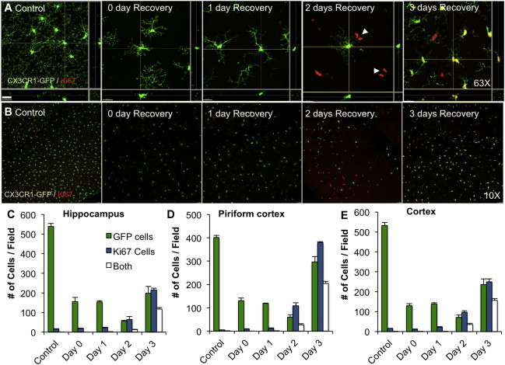
Do Microglia Last a Lifetime?
Elmore et al. Neuron, 2014;82:380-397

Slide 8
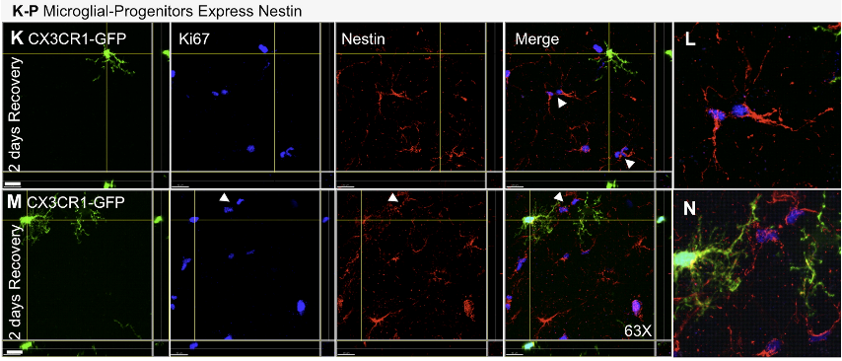
What Is The Origin Of New Microglia?
Adult microglia progenitors - A completely new class of cell
Elmore et al. Neuron, 2014;82:380-397

Slide 9
So What Does The Existence Of Microglia Progenitors Imply?
What is the purpose of the progenitor population?
What stimulates division and differentiation into mature microglia?
Is there replicative senescence of progenitors?
Does experience (exposure to prior inflammatory signals) leave lasting epigenetic impact on subsequent generations of microglia?

Slide 10
Does Epigentics Influence Microglia Behavior?
What is epigenetics?
The modulation of gene expression without alteration of DNA sequence.
What are known epigenetic modifiers of microglia behavior?
Maternal exposures (diet, pollution, narcotics)
Prior inflammation
Experiences/Exposures

Slide 11
Is Neuroinflammation a Therapeutic Target?
Neuroinflammation is a common feature of many neurological disorders.
Evidence suggests inflammatory responses contribute to pathophysiology.
Does the unique origin of microglia enable identification of therapeutics with less systemic toxicity?
  Are microglia progenitors a potential target for therapy?

Slide 12
In Personalized Medicine, How Will We Know If Targeted Therapy Is Working?
Functional outcomes change very slowly.
Biomarkers will help:
  Speed clinical trials (surrogate outcomes)
  Narrow trial cohorts (validate personalized indications)
MRI Changes (when present) develop slowly and may be confounded by unrelated pathologies.
Molecular biomarkers
Neuroinflammation biomarkers

Slide 13
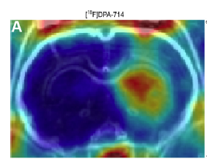
TSPO-PET: A Method to Follow The Inflammatory Response, In Vivo, Over Time
Does TSPO expression increase after TIA model?
Is TSPO induction in a TIA model specific to microglia?

Slide 14
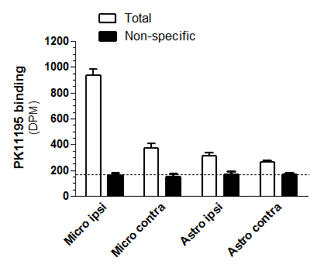
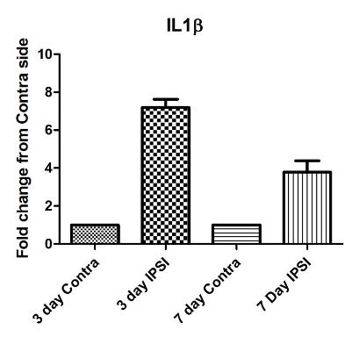
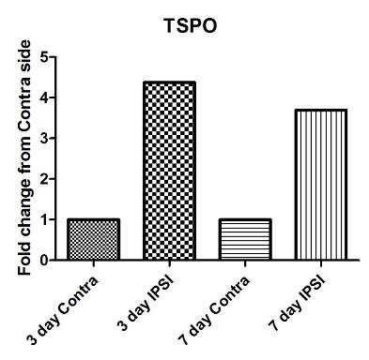
TSPO mRNA is Increased in Microglia Following Brief Ischemia/Reperfusion

Slide 15
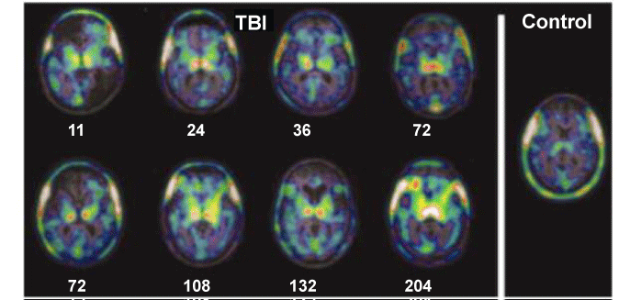
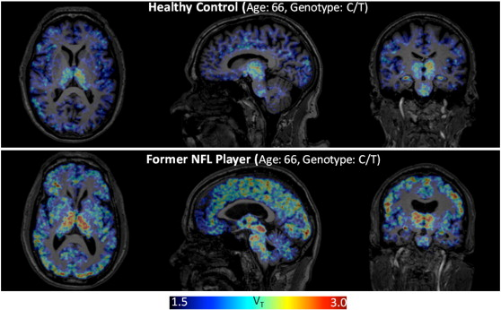
TSPO-PET Imaging Of Neuroinflammation After TBI
Caughlin et al., Neurobiology of Disease, Volume 74, 2015, 58 – 65.

Slide 16
TSPO PET – A Sensitive Marker Of Mild Inflammation
PET for TSPO ligands can be a biomarker of mild neuroinflammation.
TSPO expression is increased following a TIA model.
Increased TSPO radioligand binding is detected specifically in microglia after TIA.

Slide 17
Challenges For The Future
Develop U.S. consortia
  Combine efforts across different disease/injury groups.
  Develop academic-industry collaborations.
Improve research infrastructure
  Biomarker programs
  Pre-clinical models

